Slide 1
Demystifying Data Science
London Business Analytics Group - Feb ‘17
library(dplyr)
r-ladies_global %>%
filter(city = 'London')
@alice_data
@AnalyticsPanda

Slide 2
Who are we?

Slide 3
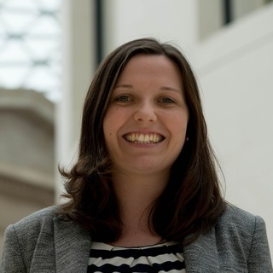

Alice Daish
Chiin-Rui Tan
Co-Founder of R-Ladies Global

Slide 4



Welcome
Notes:
Welcome to the wonderful world of Unicorns, Hippos and Elephants. Welcome to Data Science!

Slide 5
Tech Industry - not all Apps, Robots & PhDs
Data
P.S you do not have to have a PhD in Computer Science to work in Tech!!
“69% of all (coders) tell us they are at least partly self-taught.
13% of respondents across the globe tell us they are only self-taught.”
Hardware
Software
—Stack Overflow
Developer Survey Results 2016
56,033 coders in 173 countries

Slide 6
What is Data Science?
Our suggestion:
“The application of scientific methods to Data which enable new discoveries to be made & utilised”
General consensus = There is no consensus!
DJ Patil & Jeff Hammerbacher purport to have first coined the term “Data Scientist” as a job title in 2008
Hybrid & Interdisciplinary
P.S Don’t assume an Organisation recruiting for a Data Scientist actually knows what a Data Scientist is…..!
Computer Science
Maths & Statistics Knowledge
Domain Expertise
Communication & Empathy
(Trusted Advisor)

Slide 7
Data Science - Misconceptions
Data Science != Hadoop
Data Science != Big Data
Data Science != Machine Learning
Data Science != Just Programming
Data Science != Successful Data Science

Slide 8
Skills

Slide 9
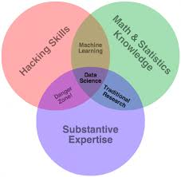
Venn Timeline
2010
Drew Conway 2010
Steven
Geringer
2014
David Taylor - http://www.kdnuggets.com/2016/10/battle-data-science-venn-diagrams.html

Slide 10
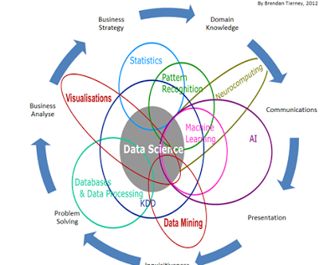
Venn Timeline
2010
2012
Drew Conway 2010
David Taylor - http://www.kdnuggets.com/2016/10/battle-data-science-venn-diagrams.html

Slide 11
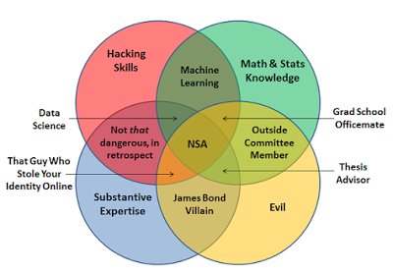
Venn Timeline
2010
2012
2013
Drew Conway 2010
Brendan
Tierney
2012
Joel Grus 2013
Steven
Geringer
2014
David Taylor - http://www.kdnuggets.com/2016/10/battle-data-science-venn-diagrams.html

Slide 12
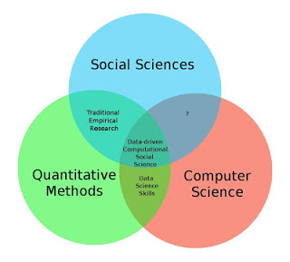
Venn Timeline
2010
2012
2013
Drew Conway 2010
Brendan
Tierney
2012
Joel Grus 2013
Steven
Geringer
2014
Ulrich Matter 2013
David Taylor - http://www.kdnuggets.com/2016/10/battle-data-science-venn-diagrams.html

Slide 13
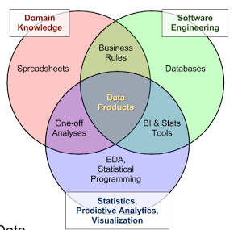
Venn Timeline
2010
2012
2013
Drew Conway 2010
Brendan
Tierney
2012
Joel Grus 2013
Harlan
Harris
2013
Steven
Geringer
2014
Ulrich Matter 2013
David Taylor - http://www.kdnuggets.com/2016/10/battle-data-science-venn-diagrams.html

Slide 14
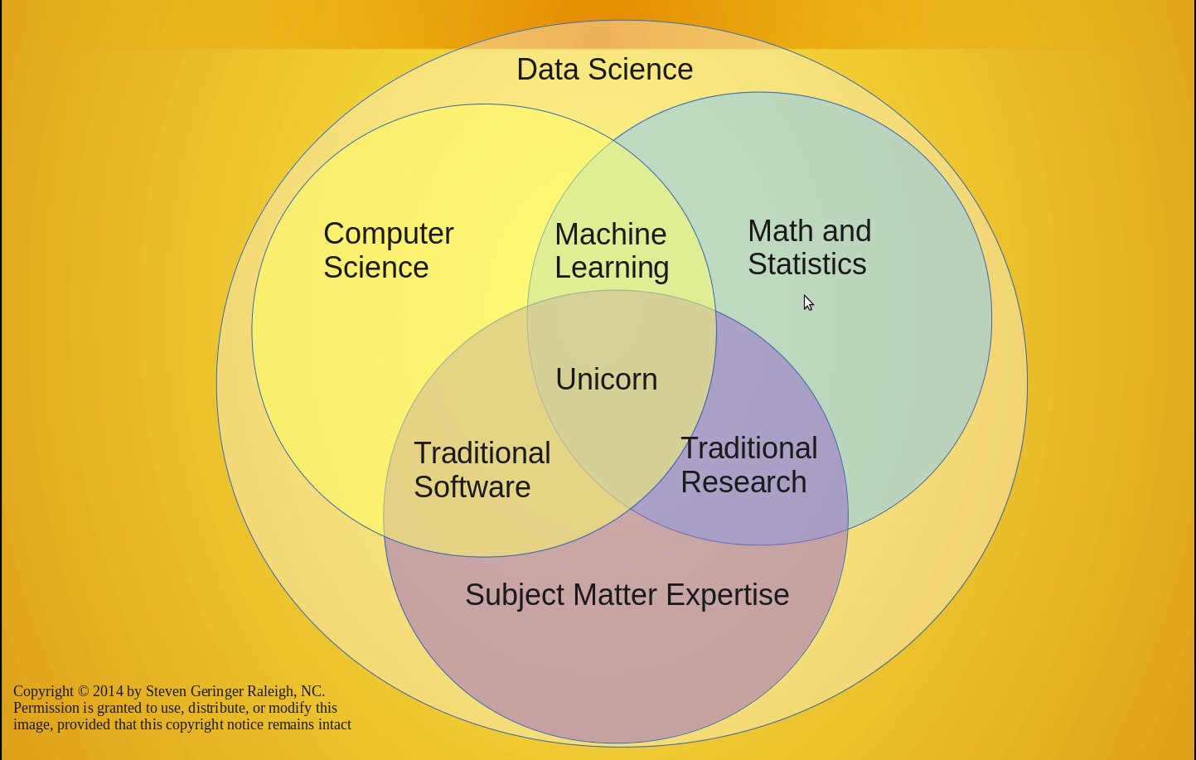
Venn Timeline
2010
2012
2013
Drew Conway 2010
Brendan
Tierney
2012
Joel Grus 2013
2014
Harlan
Harris
2013
Steven
Geringer
2014
Steven
Geringer
2014
Ulrich Matter 2013
David Taylor - http://www.kdnuggets.com/2016/10/battle-data-science-venn-diagrams.html

Slide 15
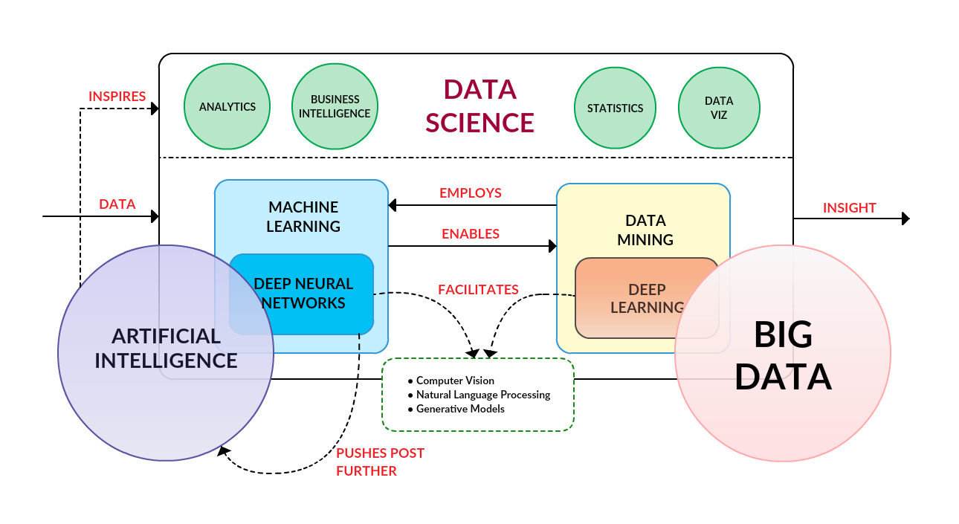
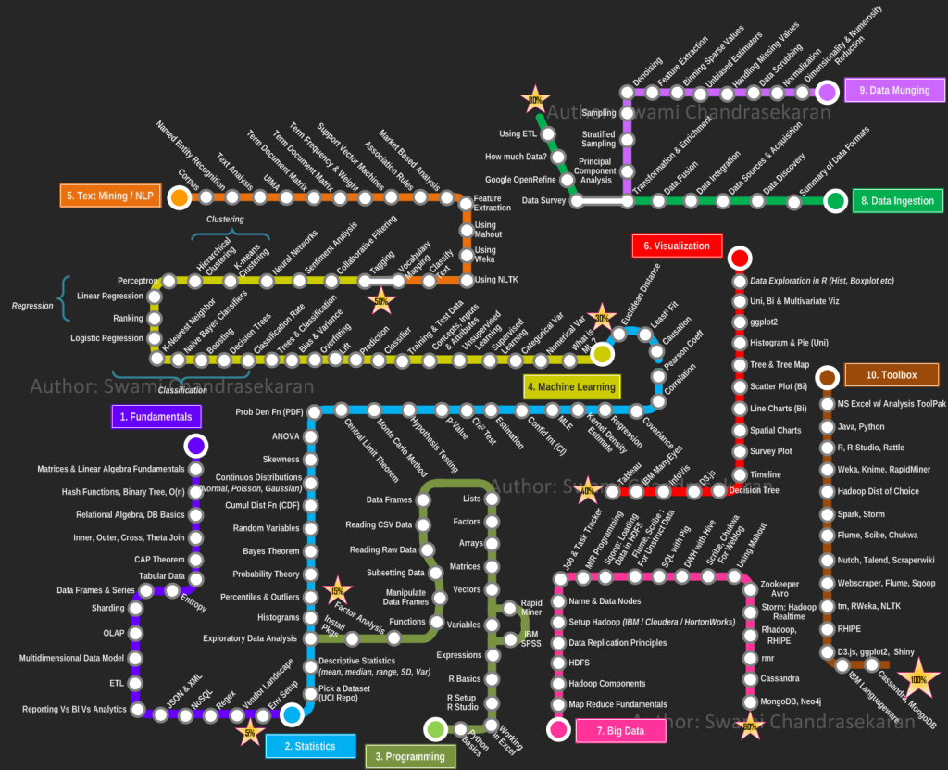
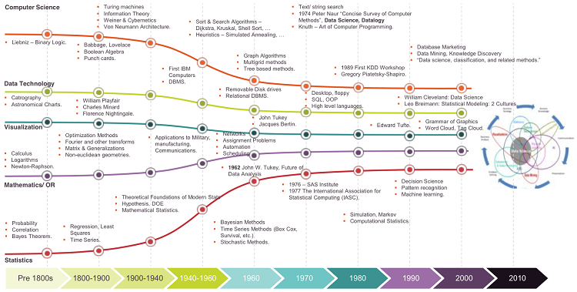
http://www.kdnuggets.com/2016/10/deep-learning-key-terms-explained.html
http://www.forbes.com/sites/gilpress/2013/05/28/a-very-short-history-of-data-science/
http://nirvacana.com/thoughts/becoming-a-data-scientist/

Slide 16
Data Science context - Micro & Macro
Data Engineer
Distributed Computing
Data Scientist
Business Dashboards & Data Democratisation:
Tableau, Shiny
Business Intelligence
Advanced Data Structures
Knowledge of new
& emerging tools:
Hadoop, Spark, Hive
Evangelism
Data Mining
Data Modelling
Visualisation:
D3, R, Python
Data Warehousing
Data Governance
Security
Stakeholder Management
Hacking/
Problem-Solving
Data Extraction:
APIs, SQL
Building ETL & Pipeline design
Insight/
Story-telling
Programming:
R, Python, SQL, C, C++
Machine Learning:
R, Python, Tensor Flow
Software Engineer
Advisory/ Consultancy
Frontend & Backend Development
Statistical Modeling:
R, Matlab, Stata, SPSS
Version Control:
GitHub
Project Management
Algorithms
Web &
Mobile Apps
Domain Knowledge
Reproducible Research
Product Services & Design
Operational System Development
Inspired by http://101.datascience.community/tag/data-engineering/

Slide 17
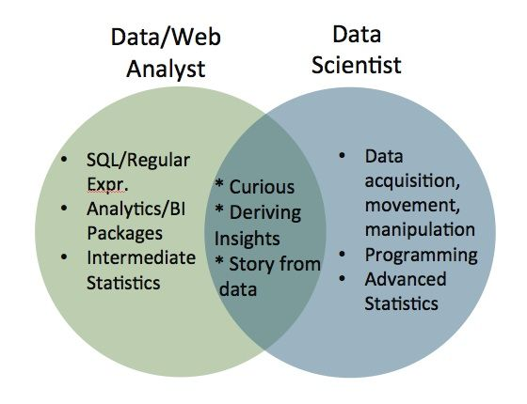
Data Science in context - Macro & Micro
Data Engineer
Advance data structures
Distributed computing
Data Scientist
Knowledge of new & emerging tools - Hadoop, Spark, Hive etc.
Machine Learning:
R, Python, Tensor Flow
Algorithms
Business Intelligence
Security
Data Modelling
Programming:
R, Python, SQL
Data Extraction:
APIs, SQL
Data Warehousing
Evangelism
Visualisation:
D3, R, Python
Data Mining
Stakeholder Management
Building ETL & Pipeline design
Advisory / Consultancy
Data Governance
C, C++, Microsoft SQL server
Story-telling
Software Engineer
Project Management
Business Dashboards & Data Democratisation:
Tableau, Shiny
Reproducible Research:
GitHub
Frontend & Backend Development
Domain Knowledge
Statistical Modeling:
R, Matlab, Stata, SPSS
Hacking\
Problem-Solving
Web &
Mobile Apps
Product Services & Design
Data-Driven Insight
Research
Operational System dev
Inspired by http://101.datascience.community/tag/data-engineering/

Slide 18
Hype

Slide 19
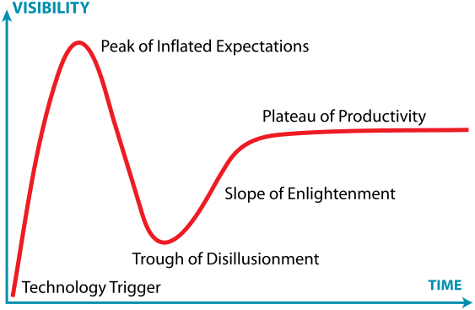
Hype Cycle
https://en.wikipedia.org/wiki/Hype_cycle

Slide 20
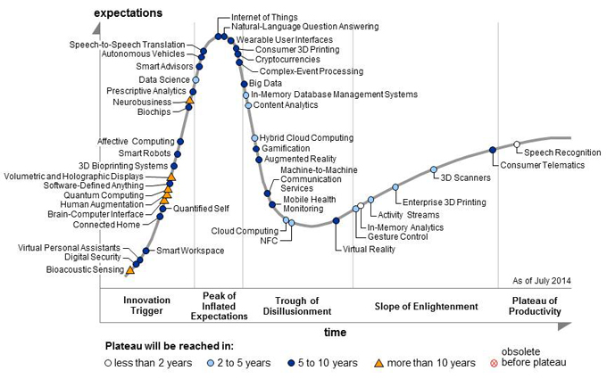
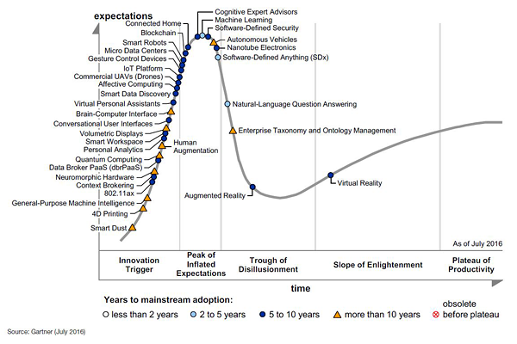
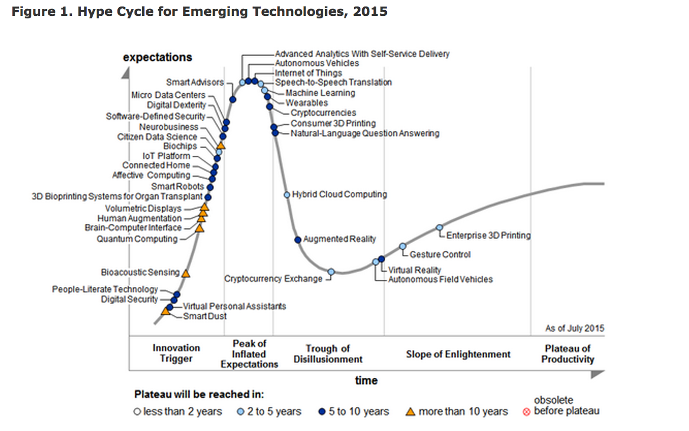
Hype Cycle - Silver Bullets?
2014
2016
2014
2015
http://www.gartner.com/

Slide 21
Hype Cycles - Has Data Science survived?
Data Science does not start by analysing big data but instead by asking key business questions.
What do we know?
What do we not know?
What have not been answered yet?
What are the known unknowns?
What are the known known?
YES
“Data Science is about discovering and showing people things they didn’t know using data.”
http://datasciencelondon.org/data-science-london/

Slide 22
Workflow

Slide 23
Data Science - Workflow
Receive or Identify:
-business problem
-research question
-hypothesis
-project brief
Design Work
Collect
Munge
& Wrangle
Data
Analyse
& Model
Create:
-output
-insight/finding
-product
-deliverable
Effectively:
-inform/affect
-communicate
-implement
-get adoption
Impact
Visualise
Evaluate Impact

Slide 24
Data Science - Workflow
Receive or Identify:
-business problem
-research question
-hypothesis
-project brief
Computational data skills are Necessary but not Sufficient!!
Design Work
Collect
Munge
& Wrangle
Data
Analyse
& Model
Create:
-output
-insight/finding
-product
-deliverable
Effectively:
-inform/affect
-communicate
-implement
-get adoption
Impact
Visualise
Evaluate Impact

Slide 25
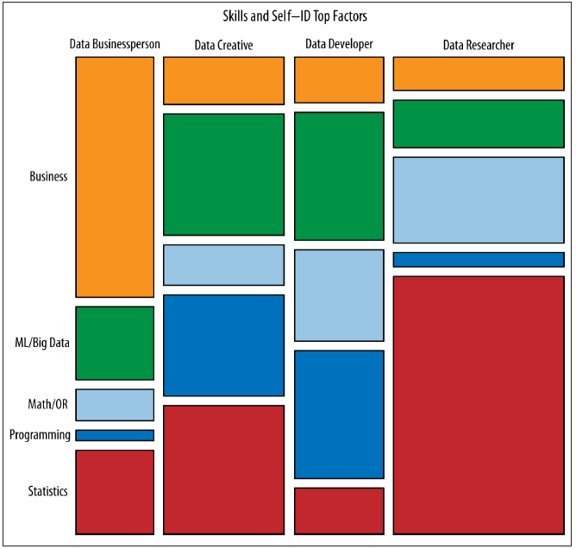
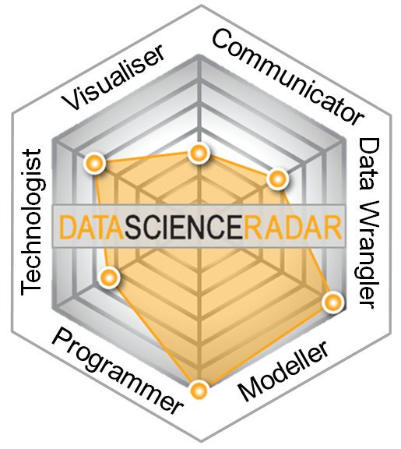
Data Science - The Unicorn = Group of Horses
https://www.mango-solutions.com/radar/
http://radar.oreilly.com/2013/06/theres-more-than-one-kind-of-data-scientist.html

Slide 26
Data Science - The Unicorn = Group of Horses
Data Businesspeople are the product and profit-focused data scientists. They’re leaders, managers, and entrepreneurs, but with a technical bent. A common educational path is an engineering degree paired with an MBA.
Data Creatives are eclectic jacks-of-all-trades, able to work with a broad range of data and tools. They may think of themselves as artists or hackers, and excel at visualization and open source technologies.
Data Developers are focused on writing software to do analytic, statistical, and machine learning tasks, often in production environments. They often have computer science degrees, and often work with so-called “big data”.
Data Researchers apply their scientific training, and the tools and techniques they learned in academia, to organizational data. They may have PhDs, and their creative applications of mathematical tools yields valuable insights and products.
http://radar.oreilly.com/2013/06/theres-more-than-one-kind-of-data-scientist.html

Slide 27
Data Science Workflow
Receive or Identify:
-business problem
-research question
-hypothesis
-project brief
Data Business
person
Data Researcher/
Creative/
Developer
Design Work
Collect
Data Business
person
Munge
& Wrangle
Data
Analyse
& Model
Create:
-output
-insight/finding
-product
-deliverable
Effectively:
-inform/affect
-communicate
-implement
-get adoption
Impact
Data Business
person
Visualise
Evaluate Impact

Slide 28
Pitfalls

Slide 29
Data Science Pitfalls - Noise
You

Slide 30
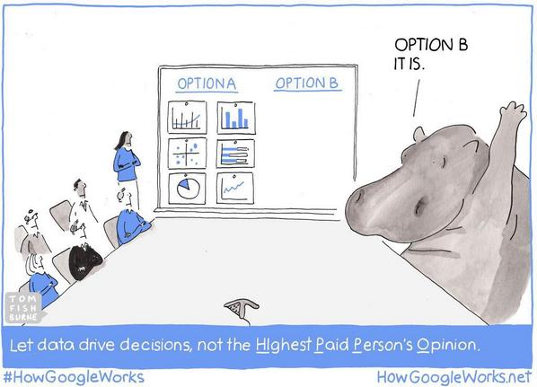
Data Science Pitfalls - Beware of the HiPPO!
Notes:
Alice
It’s your job to build a culture that trusts data not the hippo.
Experience is important for any business but listening to data to help make an informed decision is equally important.
Build trust with all your stakeholders big or small
Understanding business needs and priorities without being steered or push by other individuals or department agendas or priorities.

Slide 31
Data Science Pitfalls - Wrong Question
Precise Answer
“Far better an approximate answer to the right question, which is often vague, than an exact answer to the wrong question, which can always be made precise.”
Target
—John W. Tukey
The Future of Data Analysis (July 1961)
Wrong Question
Right Question
Approximate Answer

Slide 32
Data Science - Pitfalls
“80%
of Data Science projects never go to production”

Slide 33
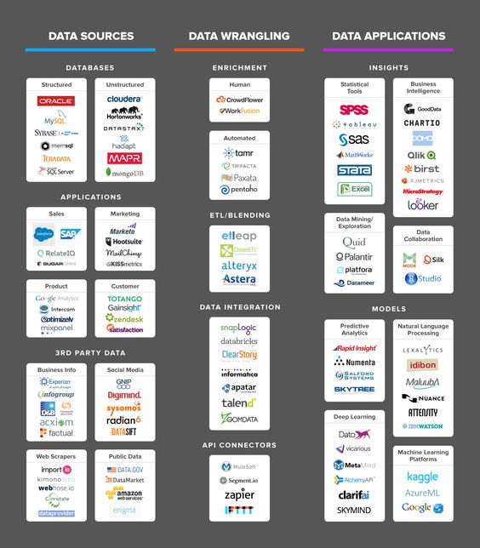
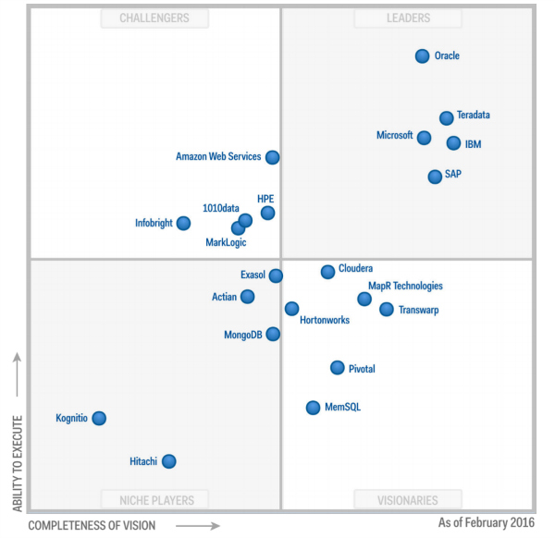
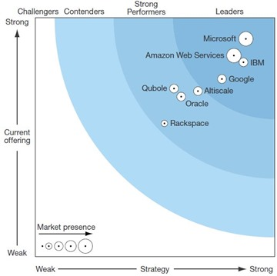
NO SOLUTION IS A SILVER BULLET
Analytics Gartner 2016
https://www.crowdflower.com/the-data-science-ecosystem/
Big Data Forrester 2016

Slide 34

Data Science Pitfalls - Blind Leading the Blind?
What you'll do:
Understand Co-op objectives, and create algorithms that deliver positive impacts for members
Be capable and confident in tackling the most complex data-driven and analytical problems
Work across several simultaneous projects with partners from various Co-op businesses
Take on different roles on different projects (expert adviser/statistical guru/lead developer)
Write code when you need to in order to tackle and troubleshoot the most complex tasks
Make sure new problem solving approaches comply with existing Co-op rules and values
Plan projects over a 12 month horizon, and manage budgets using Agile principles
Contribute to the coaching & mentoring of a pool of less experienced colleagues
Design solutions that create outputs which are accessible to non-technical audiences
Be a great advocate for Data Science, promoting our services to Co-op colleagues
£60,000 to £80,000 p.a
We're looking to recruit an experienced Data Scientist to join our team, and unearth information from our data assets that'll help Co-op make smarter decisions for our members. You'll work as an internal data consultant with people from right across the Co-op family to find simple solutions to complex problems. And if you can bring us the combination of data expertise & great people skills we need, we can offer you a unique opportunity to help build our data capabilities from the ground up. To be successful as a Data Scientist at Co-op, you'll need to be an established data expert. Statistical models will be your speciality, but in addition to tried and tested technical ability, it's important you've got the skills to put these techniques to good use in our business.

Slide 35
Data Science is awesome!!!

Slide 36
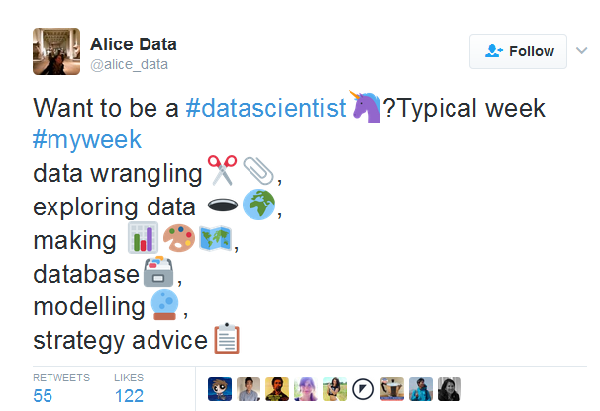
Data Science is awesome!!!

Slide 37
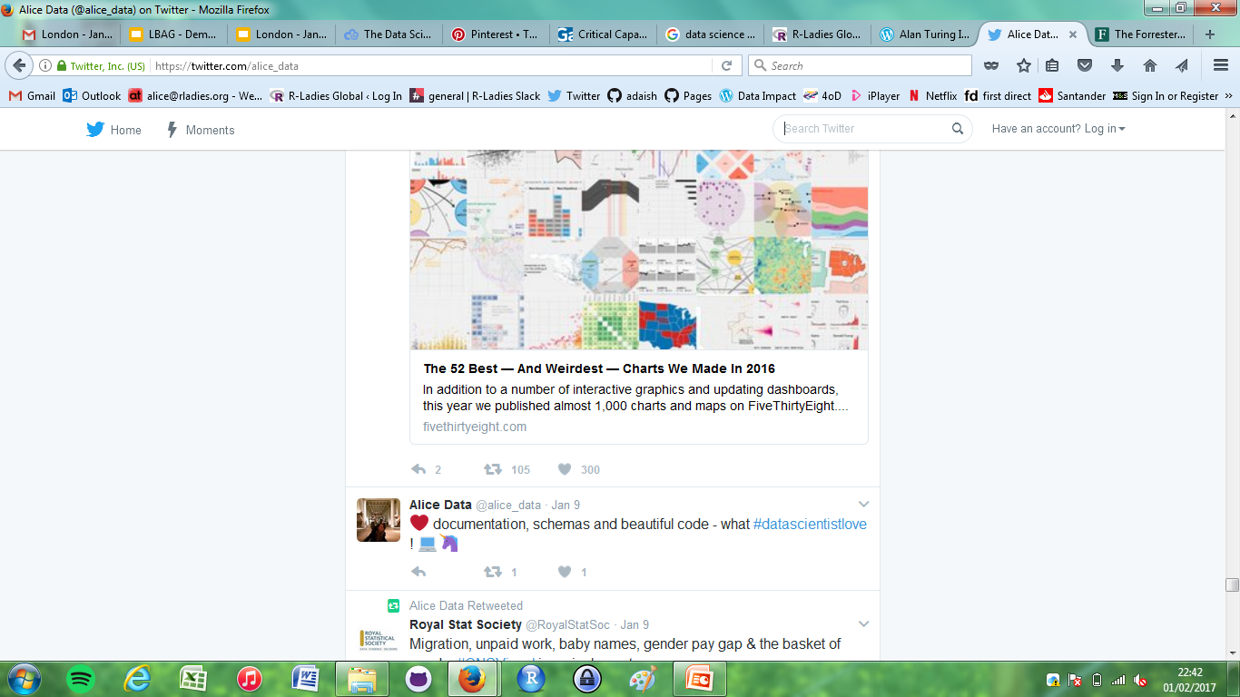
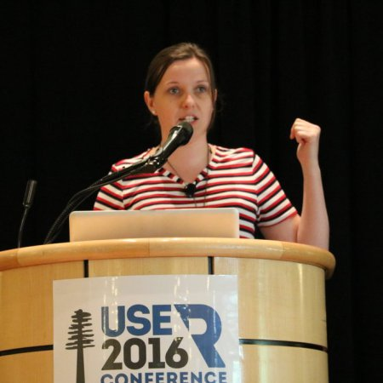
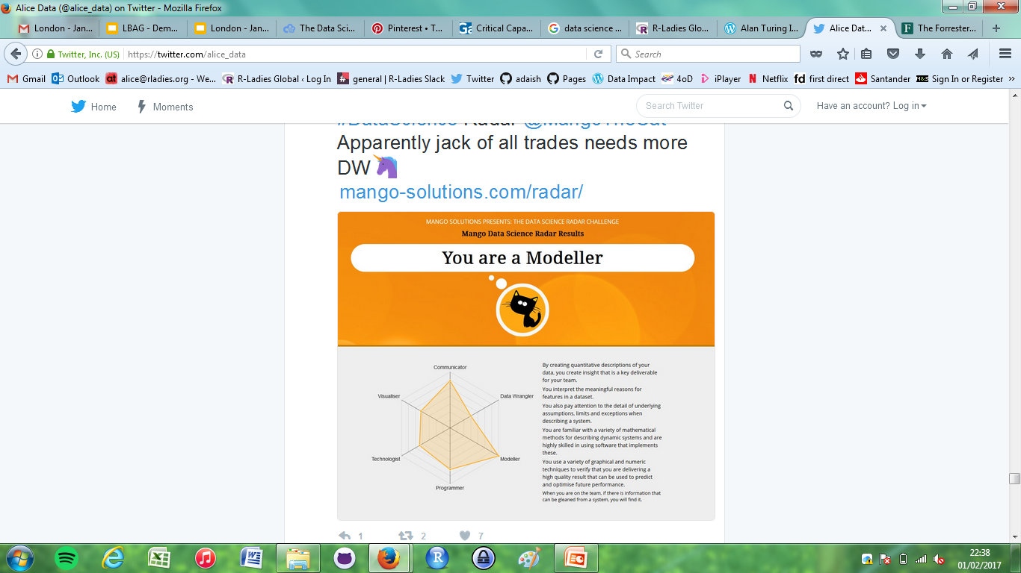
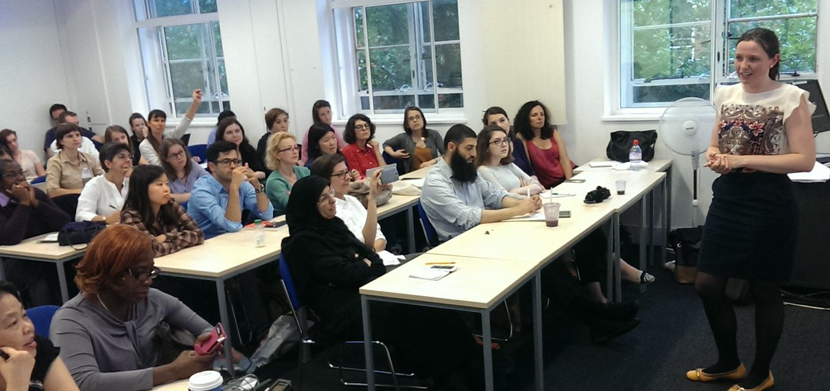
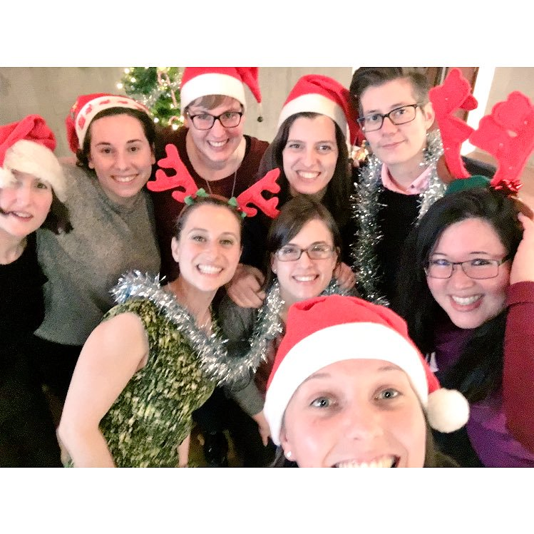
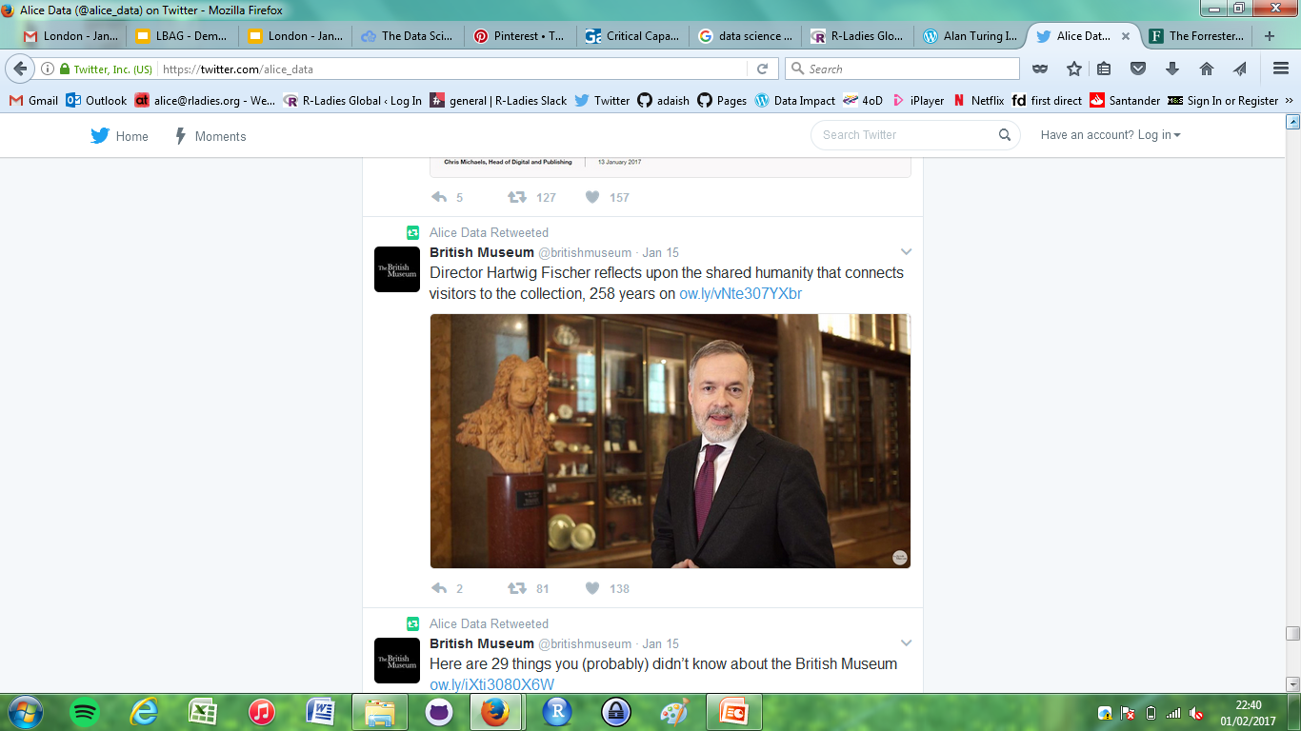
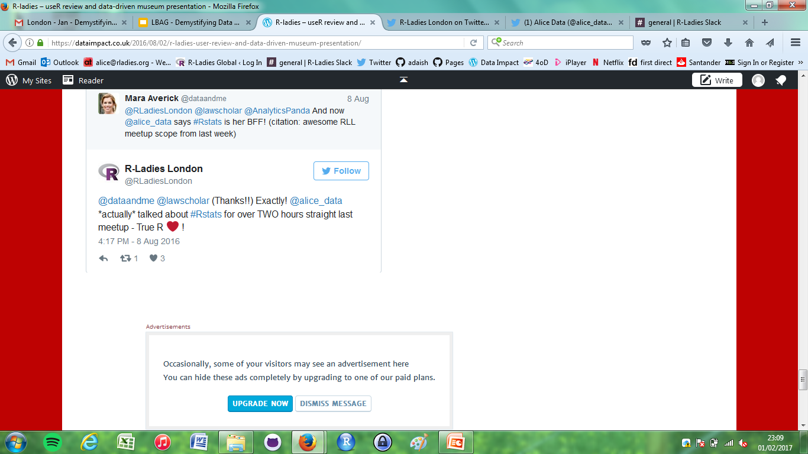
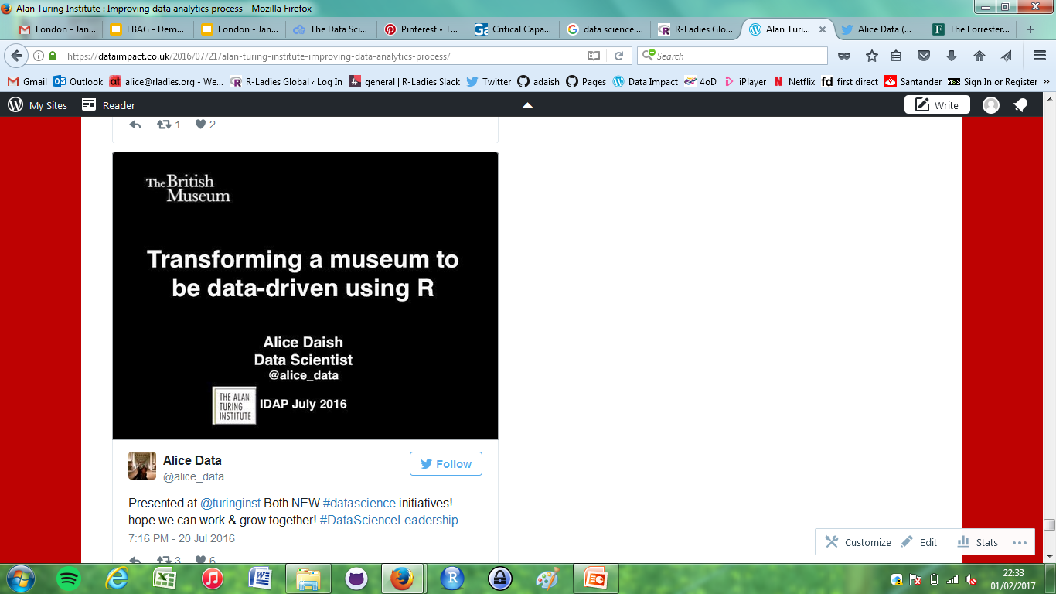
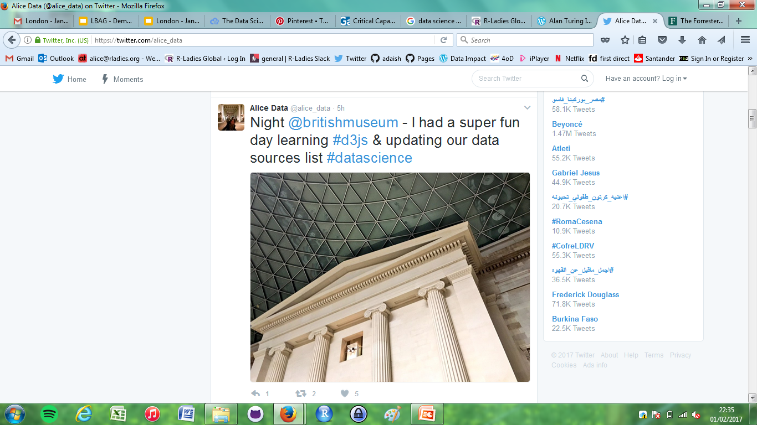


Data Science is awesome!!!

Slide 38

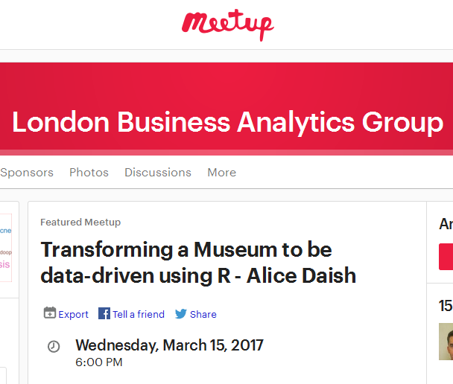
Transforming a museum to be data-driven

Slide 39
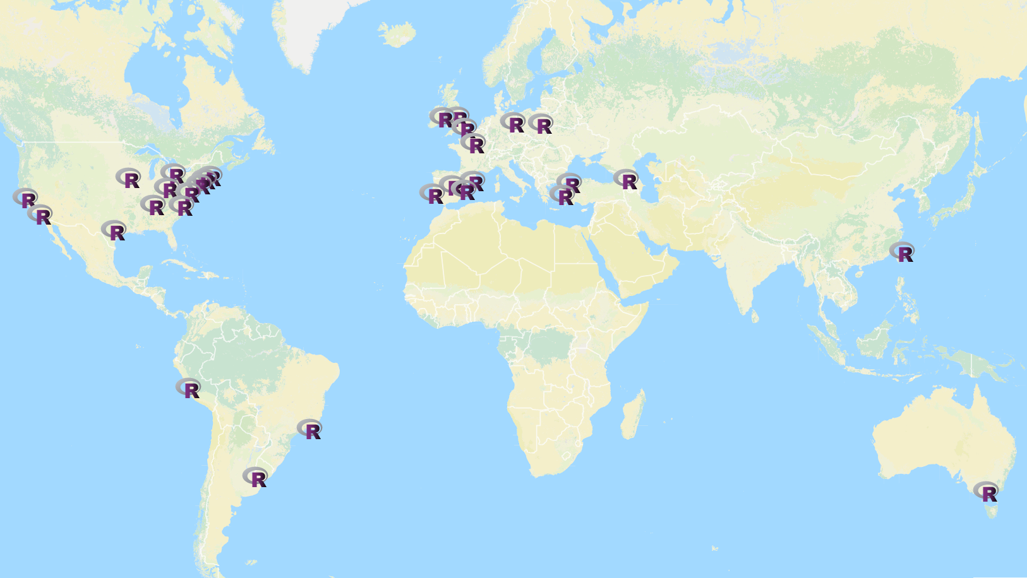
R-Ladies
Promoting Gender Diversity in the Global R community
rladies.org/
@RLadiesGlobal
@RLadiesLondon
Notes:
Chiin
What is R-Ladies?
Initiative to promote gender diversity in the global R community | Linux Foundation backed | 30+ groups in 5 months

Slide 40

R-Ladies
Promoting Gender Diversity in the Global R community
rladies.org/
@RLadiesGlobal
@RLadiesLondon

Slide 41
Thank you!
@RLadiesLondon
@alice_data
@analyticspanda
#RLadies
london@rladies.org

Slide 42
Abstract
Demystifying Data Science We all know the description of the Data Scientist being “The Sexiest Job of the 21st Century”, but do you have a clear understanding of what Data Science actually is? In this talk, Data Science practitioners Alice and Chiin will present experience-based insights that enable clarity about this undoubtedly red hot but nebulous trend, by sharing coherent definitions, frameworks, and facts that help clear up some of the key areas of confusion. They will outline their view of Data Science best-practices, common misconceptions, pitfalls, and practical tips for those looking to make a career transition. This talk will ultimately deliver awareness about the reality of the Data Science profession, and help demystify the hype.

Slide 43
Alice Daish
Alice Daish is the Data Scientist at The British Museum focusing on making the museum data-driven by 2018. Co-Founder of R- Ladies Global and mentor at R-Ladies London. Registered Scientist previously trained in ecology and quantitative biology. Interests include R and data science, datafication, data analysis, predictive modelling, data visualisation, data communication, gender diversity in STEM.

Slide 44
Chiin-Rui Tan
Chiin is the Head of Data Science at the Foreign & Commonwealth Office, leading the establishment of a new data science capability. She has an Economics degree from the University of Cambridge, and interest in applied microeconomics topics. Founder & Co-Founder of R-Ladies London & Global, Chiin is a keen R evangelist and active promoter of computing to underrepresented minorities. Professional specialisms include data-centric leadership, econometrics, digital analytics, visualisation, data democratisation, and strategic insight.

Slide 45
END

